Slide 1


Department of Computer Science and Engineering
ENHANCING AUTISM SPECTRUM DISORDER DETECTION WITH GAME-BASED ASSESSMENT
Dr. K Ananthajothi M.E.,Ph.D.,
Associate Professor
MOHANAPRIYA E 210701164
MUKHILAN S S 210701169

Slide 2
Introduction
Autism, or autism spectrum disorder (ASD), refers to a broad range of conditions characterized by challenges with social skills, repetitive behaviors, speech and nonverbal communication.
This project aims to significantly enhance the assessment and development of key skills in children with ASD through an innovative game-based approach.
By participating in various game-based scenarios, children will have opportunities to practice and improve essential skills such as communication, social interaction, and problem-solving in a supportive and enjoyable environment.

Slide 3
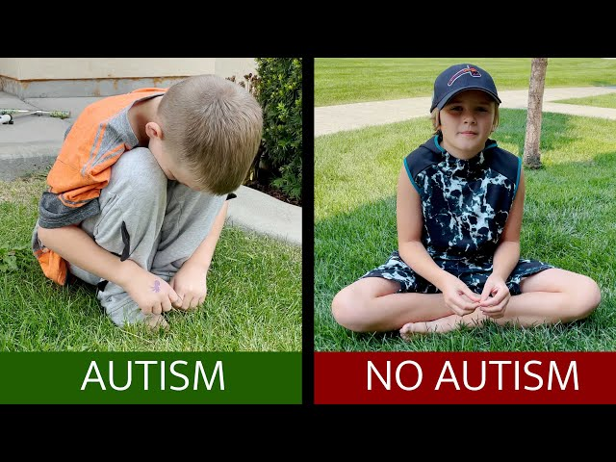
AUTISM AND NO AUTISM

Slide 4
Problem Statement and Motivation
Traditional assessment methods for Autism Spectrum Disorder (ASD) often involve formal and clinical procedures that can be intimidating and stressful for children.
These methods may not fully capture a child's range of abilities or provide an engaging way to assess crucial developmental skills such as communication, social interaction, and problem-solving.
To create a more engaging and less stressful assessment process for children with Autism Spectrum Disorder (ASD), thereby improving the accuracy of evaluations and supporting the development of crucial skills such as communication, social interaction, concentration and problem-solving is the main motivation of this project.

Slide 5
Existing System
Standardized Questionnaires and Surveys : Existing systems for assessing ASD often rely on standardized questionnaires and surveys, such as the Autism Diagnostic Observation Schedule (ADOS) and the Autism Diagnostic Interview-Revised (ADI-R). These tools involve a series of structured questions and observational tasks designed to evaluate specific behaviors and developmental milestones associated with ASD.
Medical and Psychological Evaluations : Comprehensive medical and psychological evaluations are part of the existing system for diagnosing ASD. These evaluations may include physical examinations, neurological assessments, and psychological testing to rule out other conditions and gain a thorough understanding of the child’s cognitive functioning. While these evaluations are essential for a complete diagnostic picture, they are often conducted in clinical settings that can be intimidating for the child.

Slide 6
Objectives
Engage Through Interactive Gameplay
Reduce Stress and Anxiety
Enhance Evaluation of Key Skills
Innovate Assessment Methodologies
Foster Social Skills Development
Promote Inclusivity in Game Design
Facilitate Peer Interaction and Collaboration
Enhance Motivation Through Gamification
Bridge the Gap Between Clinical and Everyday Experiences

Slide 7
Abstract
Our project focuses on developing an innovative game-based application to enhance the assessment of Autism Spectrum Disorder (ASD). Traditional assessment methods, often formal and clinical, can be intimidating for children, potentially impacting the accuracy and effectiveness of evaluations. Our approach introduces a dynamic, interactive tool designed to make the assessment process engaging and less stressful.
The application leverages advanced gamification techniques and adaptive algorithms to create a personalized and enjoyable assessment experience. By integrating interactive scenarios, the tool evaluates essential skills such as communication, social interaction, and problem-solving in a playful context. The use of real-time adaptive game mechanics allows for a tailored assessment that captures a comprehensive range of behaviors and abilities.
Through this project, we aim to not only improve the accuracy of ASD assessments but also to foster skill development and support the overall growth of children with ASD in a supportive and engaging environment.

Slide 8
Thank You

